Slide 1
OGC ISG Sprint Kickoff
Sponsor Remarks |
Susan Raymie, USSOCOM
September 1, 2020

Slide 2
Opening Remarks
Thank you to industry for your participation!
Special thanks to Khronos for collaboration with OGC on emerging standards for interoperable simulation and gaming using the same geospatial data
Appreciation to Army Geospatial Center for the results of the 3D Data Container and Tiles API Pilot
Shout out to OGC Scott Serich and to Crystal Nedik, SOCOM lead for this innovation initiative

Slide 3
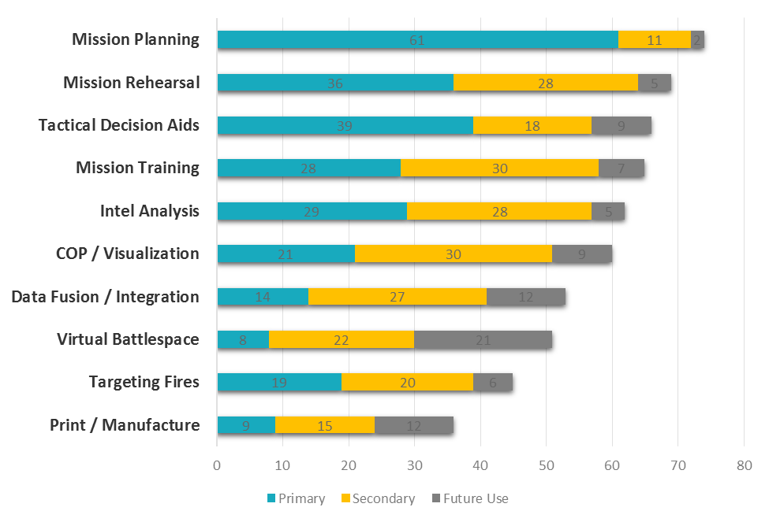
Special Operations Use Cases for ISG
Rapid Capability Insertions
C2
Intel
M&S
Leverage Gaming Technologies
Precision Effects
Data Standards & Interoperability Spark Innovation and New SOF Capabilities
All Use Cases Run on the Same High Resolution Geospatial Data

Slide 4
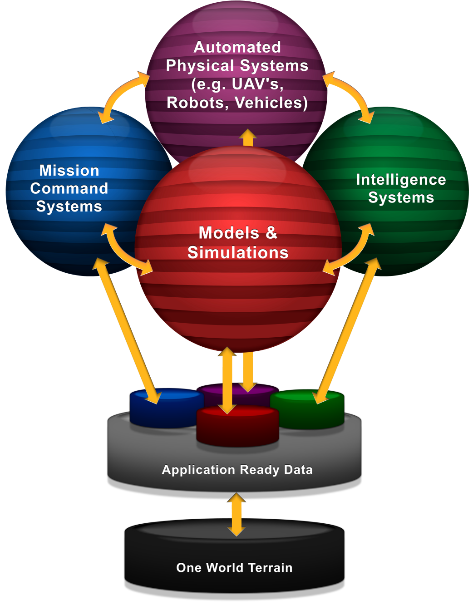
Thanks to all the Inventors
“Future GEOINT Workflow,” 2016
Be careful what you ask for because you might just get it!
Automated Interoperability of GEOINT data across warfighting functions
Innovation is coming out of the in-between space where industries collide… sparking new SOF capabilities
Foundation Data
https://external.ogc.org/twiki_public/Geospatial3DMS/WebHome

